Slide 1
SNEAKERS + Machine Learning
Kaili Hamilton
March 23, 2023
Capstone 2 Project

Slide 2

About the Data
Source: StockX (marketplace to sell and buy sneakers and other cool stuff), Kaggle
Time frame: 2015 – 2019
Only two brands/collaborators/design labels:
Yeezy (Kanye “Ye” West)
Off-White x Nike (Virgil Abloh)
50 different kinds of sneakers
99,956 sneakers sold in dataset

Slide 3
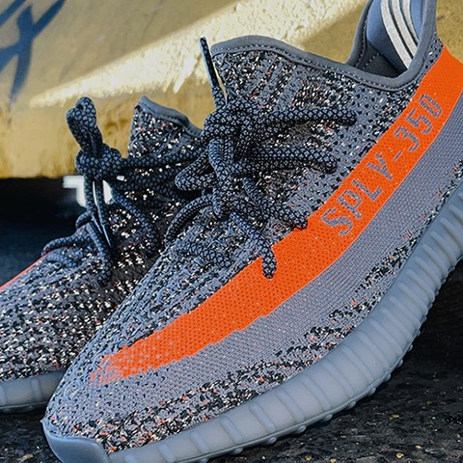
My QUESTIONS
Can I predict when the best time to resale a sneaker?
What factors are most influential in higher profits when reselling a sneaker?

Slide 4
Machine Learning Cycle
Gather & Explore Data
Found a dataset of interest on Kaggle.
Used StockX data
Pre-Process Data
Jupyter Lab, Pandas, Numpy, Matplotlib, Regex, Datetime
Exploratory Data Analysis
Changed data types
Weird stuff like a space prior to the text “Yeezy”
Extracted colorway and silhouette from one column
Created Profit Margin Column
Build Machine Learning Models & Train the Model
Tableau
Exploratory Data Analysis
Created many graphs to understand data
Evaluate the Model & Make Predictions
Looked for answers to my questions with the visuals and summary statistics.
Interpret the meaning of data
Conclusion
Tell a story of Yeezy and Off-White x Nike sneakers

Slide 5
Machine Learning Cycle
Gather & Explore Data
Pre-Process Data
Build Machine Learning Models & Train the Model
Evaluate the Model & Make Predictions
Conclusion

Slide 6
Gather & Explore data

Slide 7
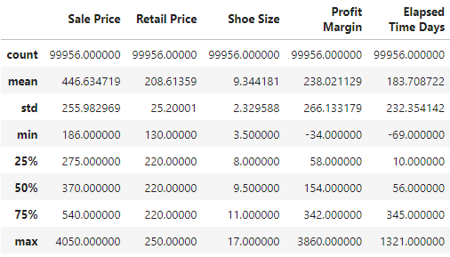
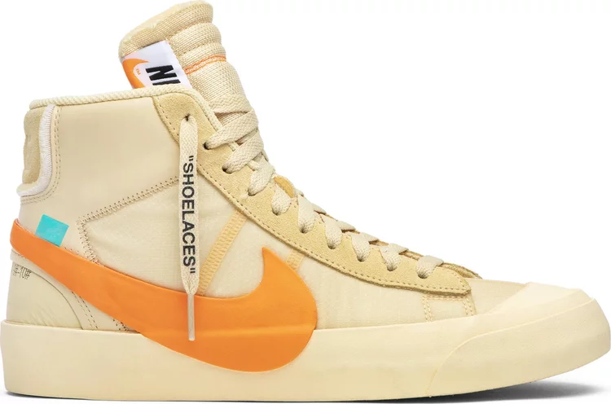
Summary Statistics

Slide 8
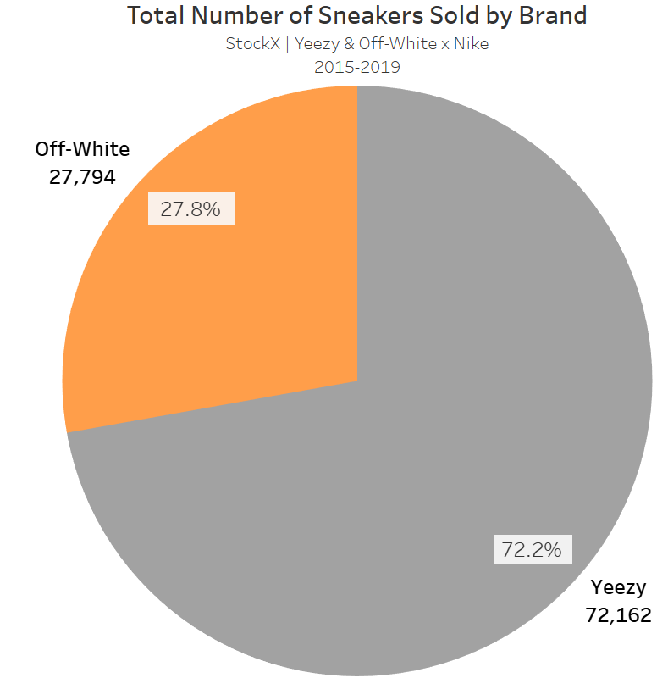
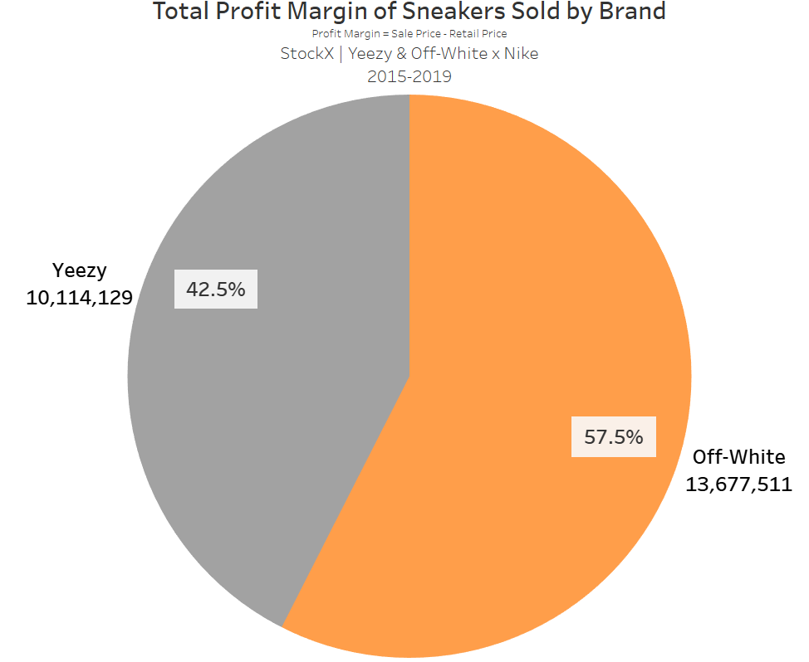
Comparing Brands
Yeezy more popular
Off-White more profitable

Slide 9
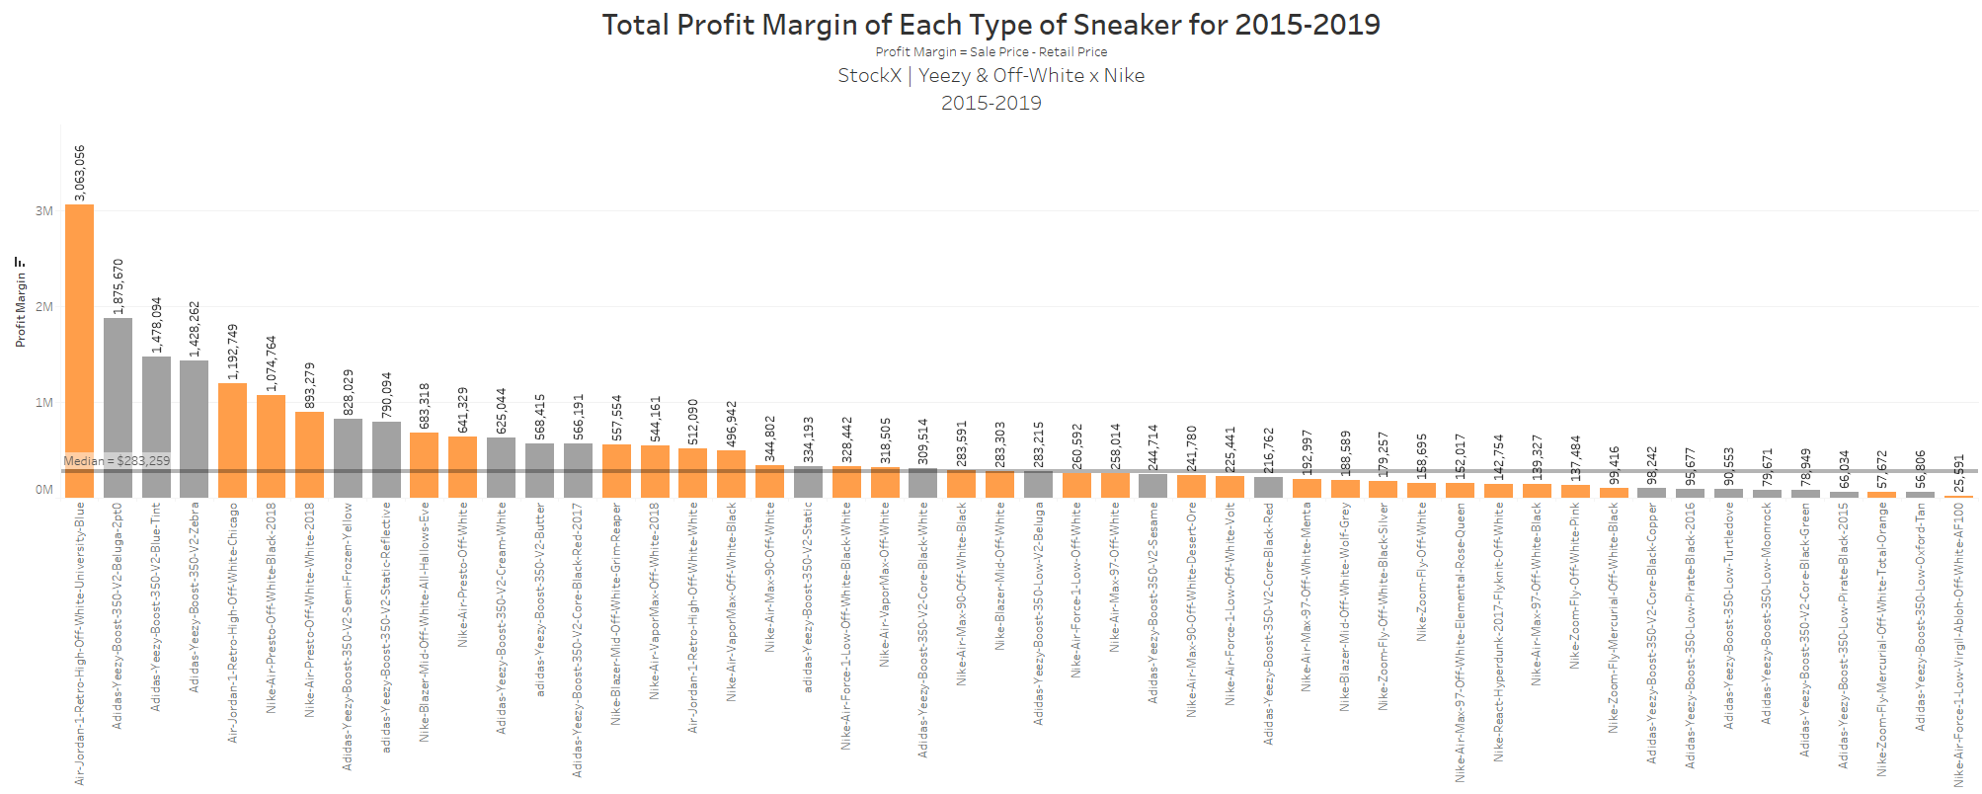

Most Profitable Sneaker: Air Jordan 1 Retro High University Blue
AJ1 Uni-Blue is 1.63 times more profitable than the next highest total profit.
Off-White x Nike has half of the top 10 spots for most total profit.

Slide 10
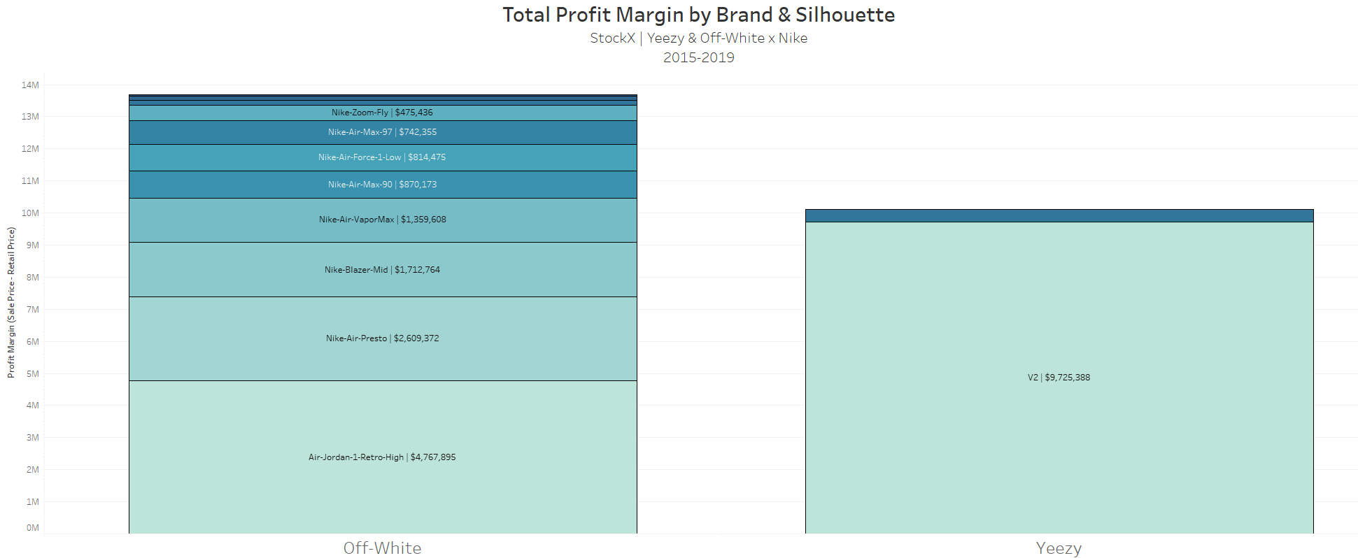
Most Profitable Silhouette: 350 v2

Slide 11
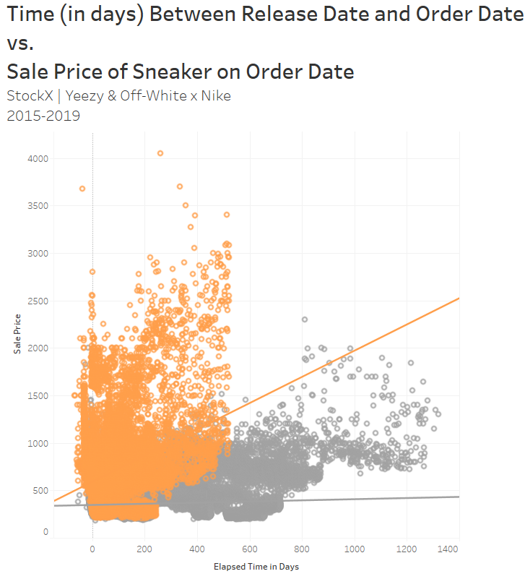
Time between release date and order date with sale price
Two clear clusters
Yeezys stayed on the market far longer than Off-White Nikes
Cluster of Off-Whites that have a higher sale price than Yeezys

Slide 12
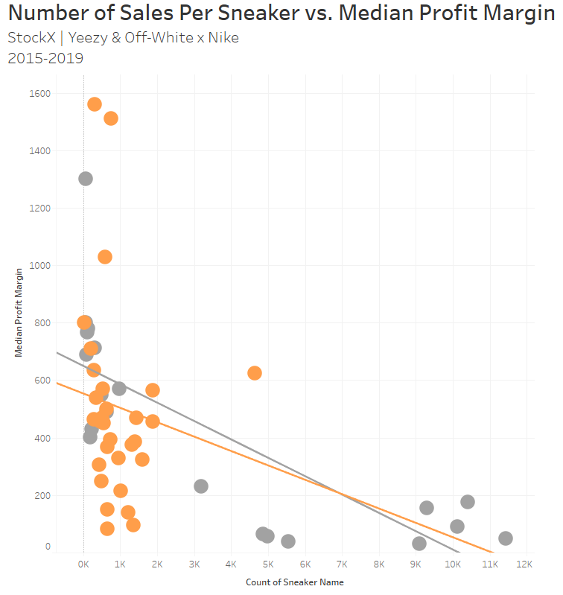
Sneakers and Sale price
The more sneakers for sale, the smaller the profit margin, especially for the Yeezys
4 possible outliers for Off-White x Nike
Overall, there are less Off-White x Nike sneakers made, which makes them more exclusive, hence the high median profit.

Slide 13
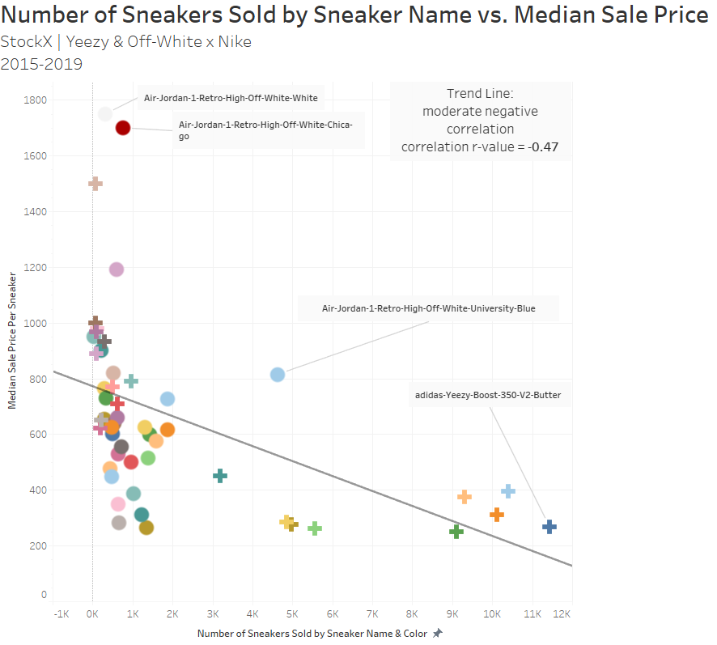

Sneakers and Sale price

Slide 14
Pre-process data

Slide 15
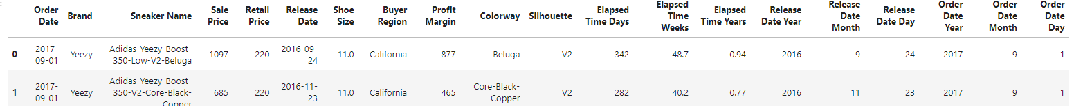
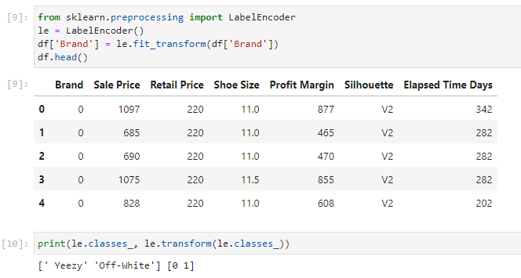
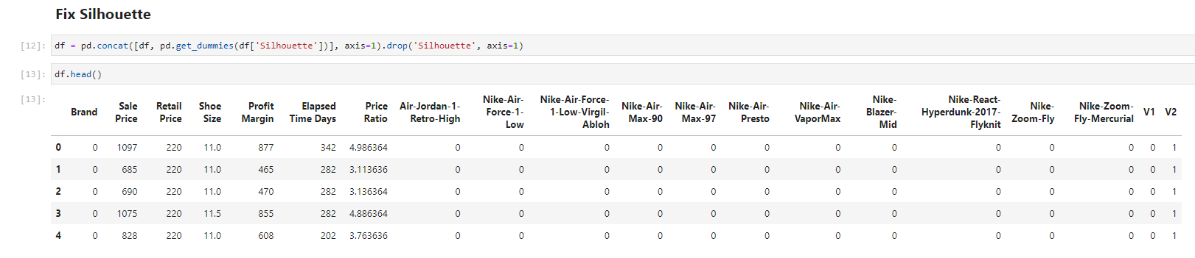
Pre-Process the Data
Dropped columns containing strings and datetime objects – machine learning can only use numerical data types
Use LabelEncoder to change Brand to 0 or 1
Used pd.get_dummies to factor in the silhouette
Added a column “Price Ratio” (percent of retail price that the shoe resold for)

Slide 16
Build Machine learning models & Train the model

Slide 17


Training & Testing Sets
Split data set into a training and testing set
I did 80% training, 20% testing
Build ML Model
Ordinary Least Square Regression (OLS)
Add a constant so regression line doesn’t have to pass through origin

Slide 18
Evaluate the model & Make predictions

Slide 19
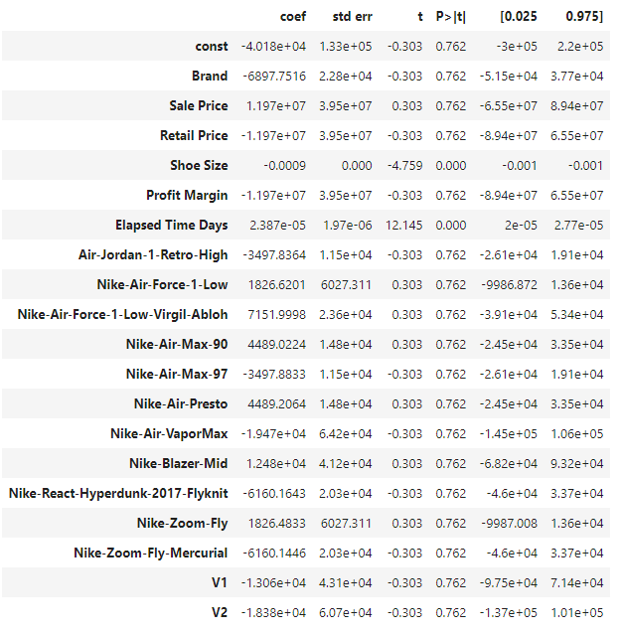
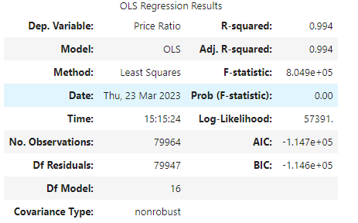

X (dropped Price Ratio) vs y (Price Ratio)
Overfitted?

Slide 20
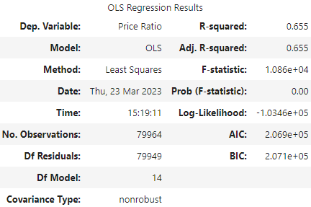
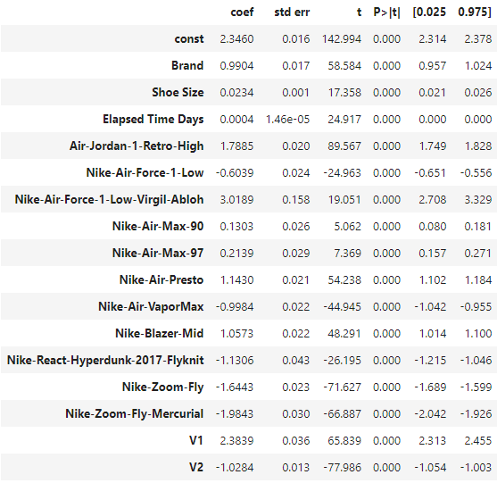

X (dropped Price Ratio, Sale Price, & Retail Price, Profit Margin) vs y (Price Ratio)
Better. But is this too specific? What about other silhouettes?

Slide 21
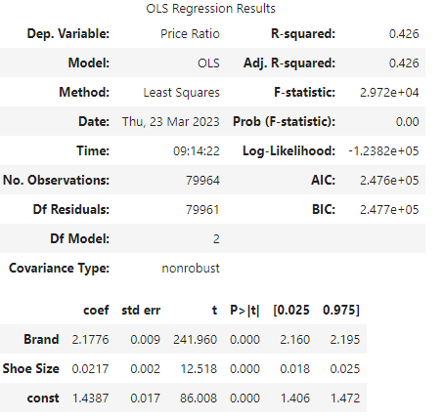

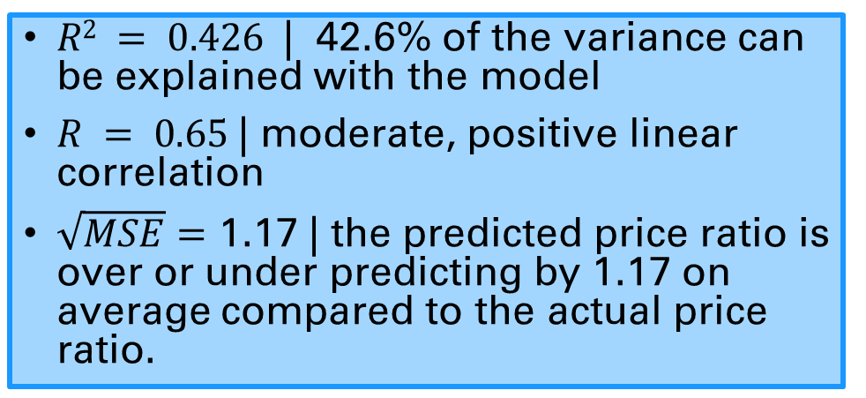
Brand & Shoe Size vs. Price Ratio
Square root of MSE = 1.17
$R2 = 0.426$| 42.6% of the variance can be explained with the model
$R = 0.65$| moderate, positive linear correlation
$\sqrt{MSE}=$ 1.17 | the predicted price ratio is over or under predicting by 1.17 on average compared to the actual price ratio.

Slide 22
Conclusions

Slide 23
Conclusions
Knowing the silhouette improves the model.
But, if you wanted to predict about all Yeezys or all Off-Whites, we’d want a more general model

Slide 24

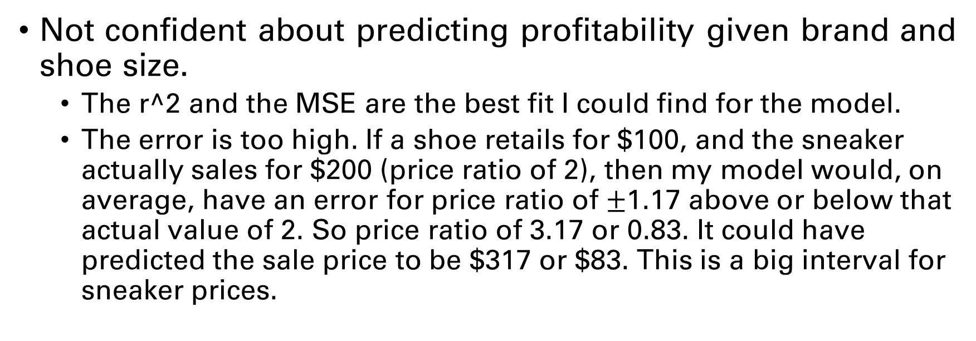

Conclusions
$$r^{2}=0.426$$
$$r=0.65$$
$$\sqrt{MSE} = 1.17$$
Not confident about predicting profitability given brand and shoe size.
The r^2 and the MSE are the best fit I could find for the model.
The error is too high. If a shoe retails for $100, and the sneaker actually sales for $200 (price ratio of 2), then my model would, on average, have an error for price ratio of $±$1.17 above or below that actual value of 2. So price ratio of 3.17 or 0.83. It could have predicted the sale price to be $317 or $83. This is a big interval for sneaker prices.

Slide 25
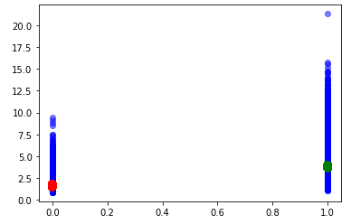
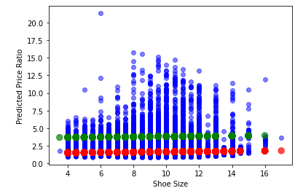
Conclusions
Influence of brand is very high in predicting price ratio.
When shoe is a 1 (Off-White Nike), the predicted price ratio goes up 218%
Off-White Nikes are generally more profitable than Yeezys.
Shoe size not as much of an influence as expected, but it did improve the model.
Predicted Price Ratio
Brand

Slide 26
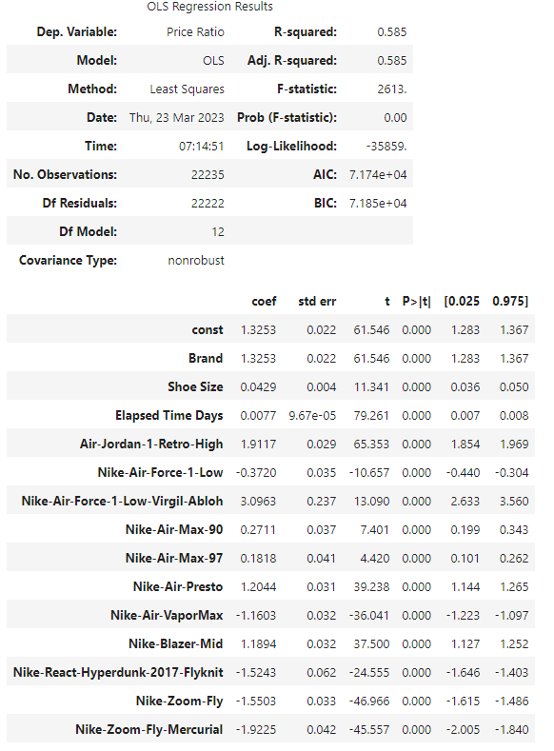

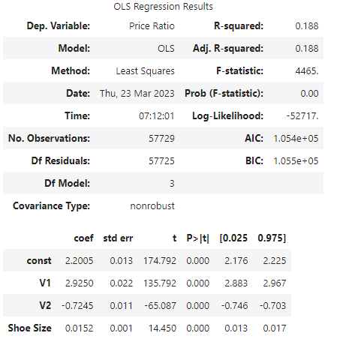

Brand Comparison
Yeezy
Off-White

Slide 27
My questions:
Can the model be improved to predict price ratio?
Other types of linear regression besides Ordinary Least Squares?
What if the data isn’t linear? How do I deal with that?
I need a review of statistics concepts like p-value, confidence interval, linear regression, mean-square error.
Any questions?

Slide 28
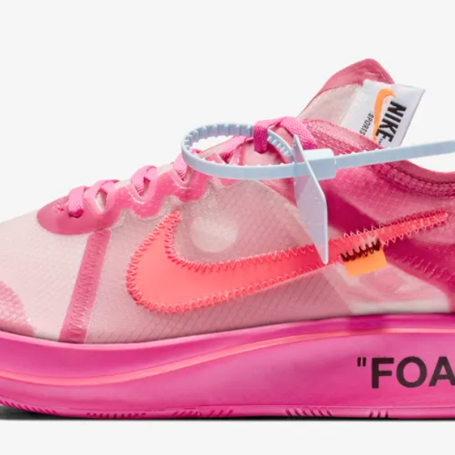
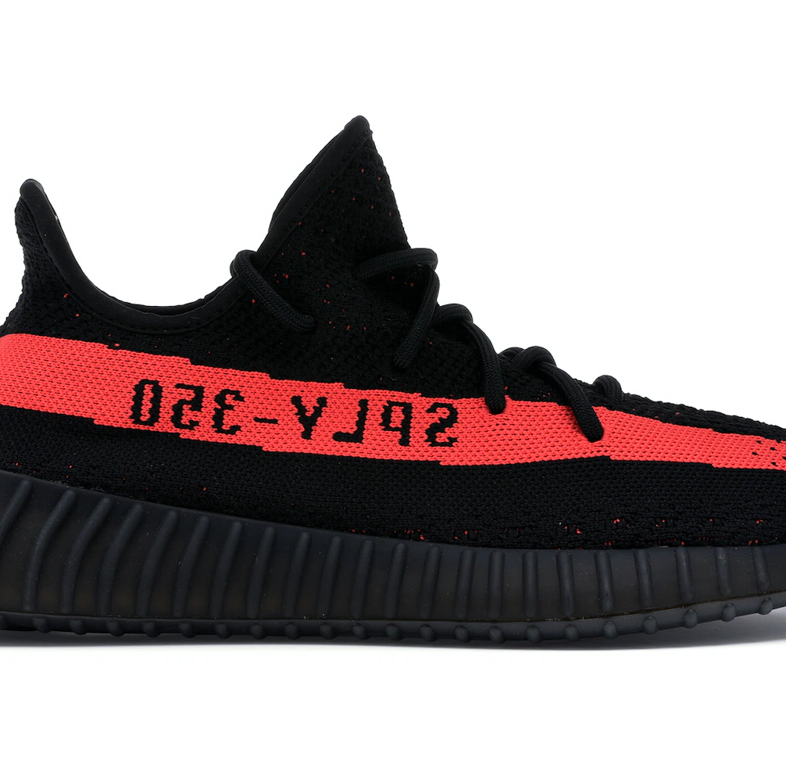
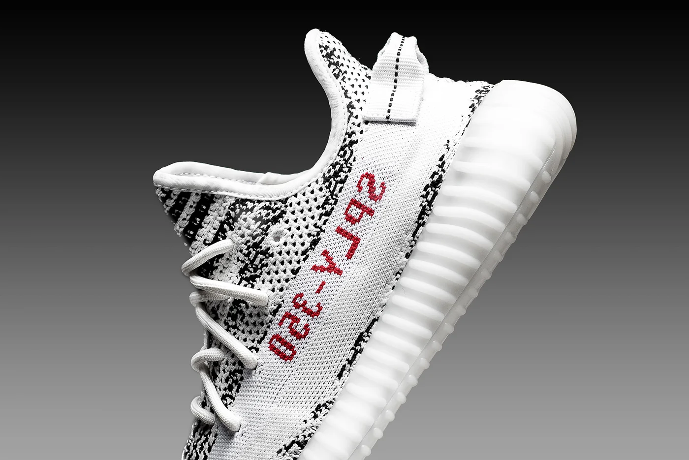
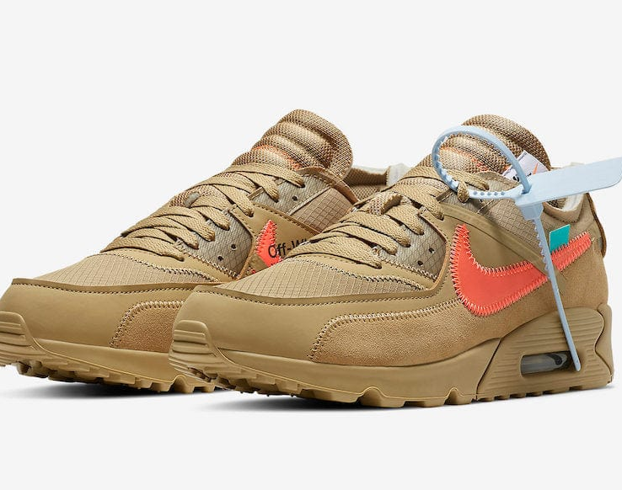
Thank you
Kaili

